Slide 1

Machine Learning Model for predicting travel insurance
MUHAMMAD AULIA RENDY
Using Python

Slide 2
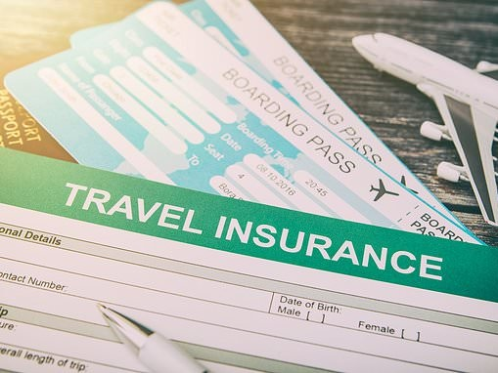
About the project
This project was carried out with the aim to build and find Machine learning model that have good result to predict whether someone will buy Travel Insurance packages or not.
2. Because in imbalanced data condition, F1 score is the proper metric to measure the model performance.

Slide 3
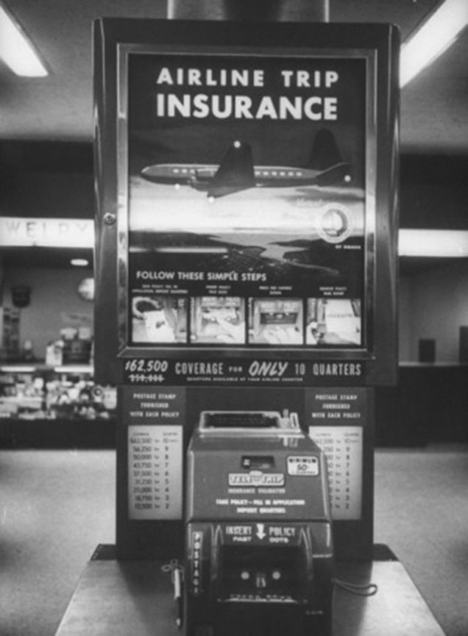
Analysis flow
Data Undestanding
Data Cleaning
Exploratory Data Analysis
Modelling
CatBoost
Naïve Bayes
Random Forest
Evaluation and Recommendation

Slide 4

Data understanding

Slide 5
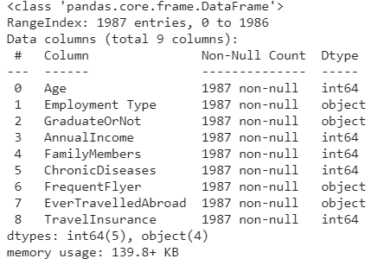
Data understanding
The data is taken from Kaggle : Travel Insurance Prediction Data
It consist 1987 rows and 9 columns
The goal of this dataset is to predict whethera customer will be interested in buying travel insurance or not

Slide 6
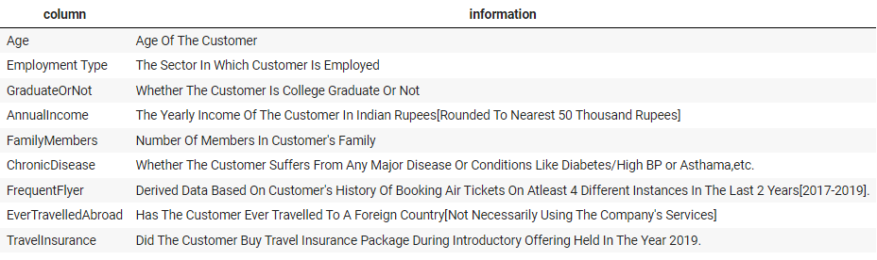
Data understanding
Data dictionary

Slide 7

Data Cleaning

Slide 8
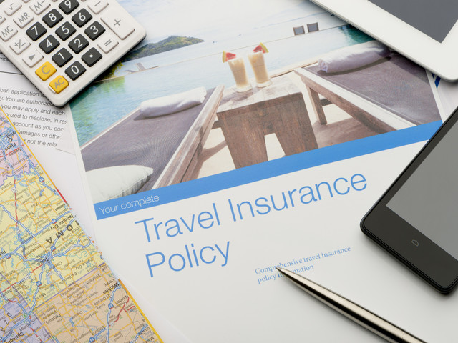


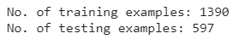
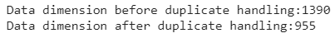
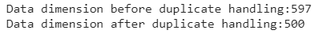
Data Cleaning
Split dataset
Duplicate check
Data train
Before we do data cleaning, we have to split between data for training dan data for testing.
Allocation between train data and test data is 70:30
Data test

Slide 9
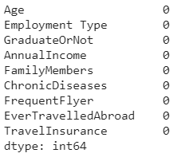
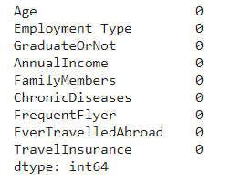
Data Cleaning
Missing Value Check
Missing Value Check
Data train
Data test

Slide 10

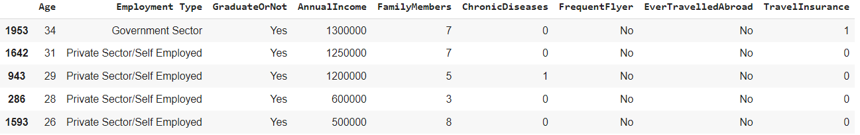
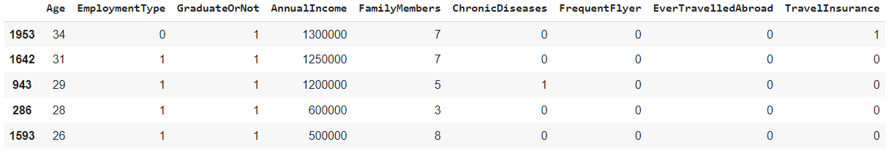

Data Cleaning
Feature Encoding
Column selected : [ Employment Type, GraduateOrNot, FrequentFlyer, EverTravelledAbroad ]
Before
After

Slide 11

Exploratory Data Analysis

Slide 12

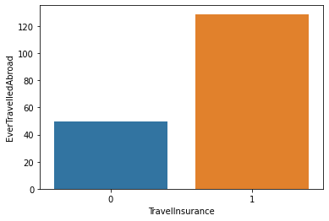
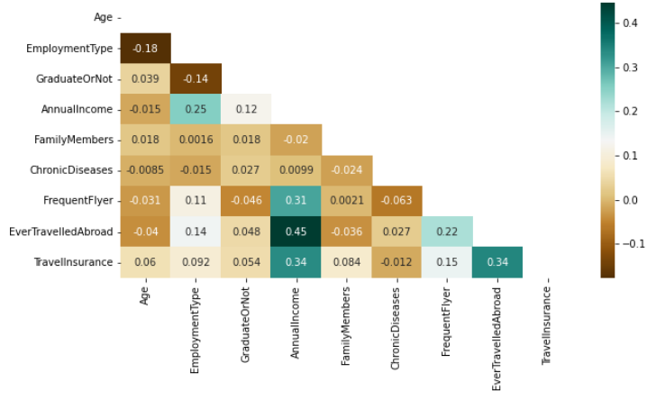
Exploratory data analysis
Most of people that ever travelled aboard tend to buy for travel insurance packages
Correlation between columns
Ever Travelled abroad vs travel insurance
All the predictors are not highly correlated with the data target(y)

Slide 13
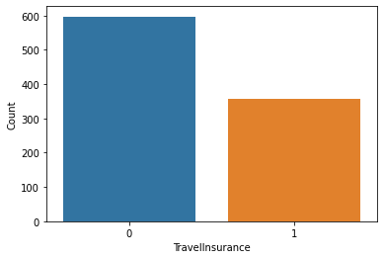
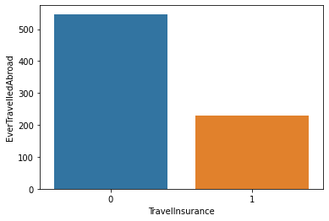
Exploratory data analysis
Ever Travelled abroad vs travel insurance
Travel insurance distribution data
Most of people that never travelled aboard,only a few buy travel insurance packages

Slide 14
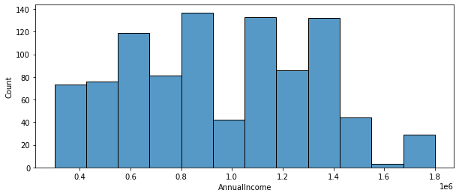
Exploratory data analysis
Annual Income (in rupee) distribution

Slide 15
Modelling

Slide 16
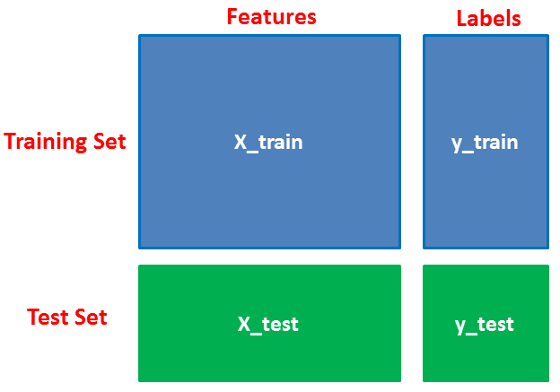
Splitting train and test data

Slide 17
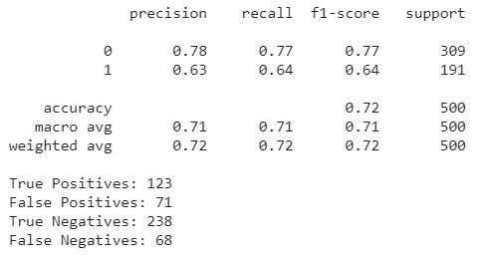
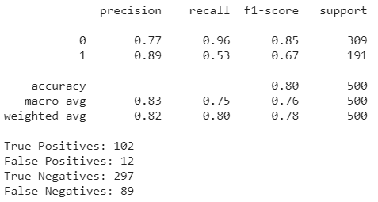
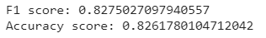
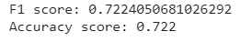
Machine learning model
Catboost
The results after resampling and setting the threshold, it can be seen that the F1 score (0 & 1) is better and the difference is not too far
Catboost with resampling and set threshold
Train
Test
Because there is an imbalance of values on the label(y), it can be seen that the F1 score (0 & 1) has a very far difference

Slide 18
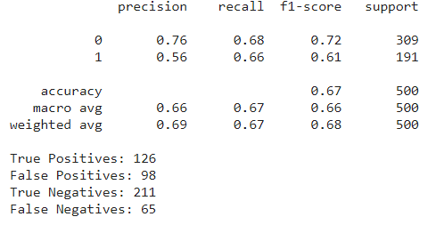
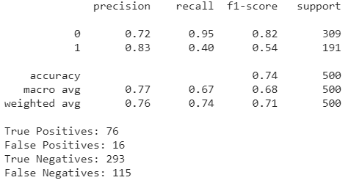
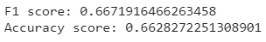
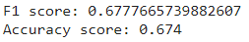
Machine learning model
Naïve bayes
The results after resampling and setting the threshold, it can be seen that the F1 score (0 & 1) is better and the difference is not too far
Naïve bayes with resampling and set threshold
Because there is an imbalance of values on the label(y), it can be seen that the F1 score (0 & 1) has a very far difference
Train
Test

Slide 19
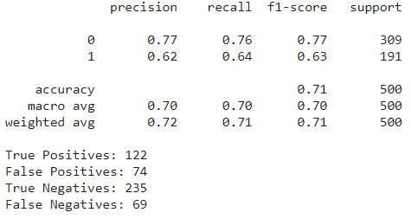
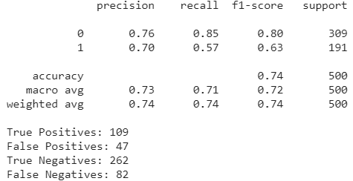
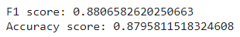
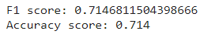
Machine learning model
Random Forest
The results after resampling and setting the threshold, it can be seen that the F1 score (0 & 1) is better and the difference is not too far
Random Forest
with resampling and set threshold
Because there is an imbalance of values on the label(y), it can be seen that the F1 score (0 & 1) has a very far difference
Train
Test

Slide 20

Evaluation metric and recommendation

Slide 21
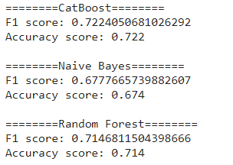
Evaluation metric
Model Result metric
After the imbalance problem was solved by resampling and set threshold, it was found that the machine learning catboost model gave better F1 score results than the others 2 models.
Because in imbalanced data condition, F1 score is the metric to measure the model performance.

Slide 22
Recommendation
In order to produce good prediction results, here are recommendations for the travel insurance dataset:
It is necessary to add features that have a strong correlation with the target data to be able to improve prediction results using machine learning models
It is necessary to increase the number of data/observation, so the data will has a balance of values in the target column(y).

Slide 23

Thank you

